Slide 1
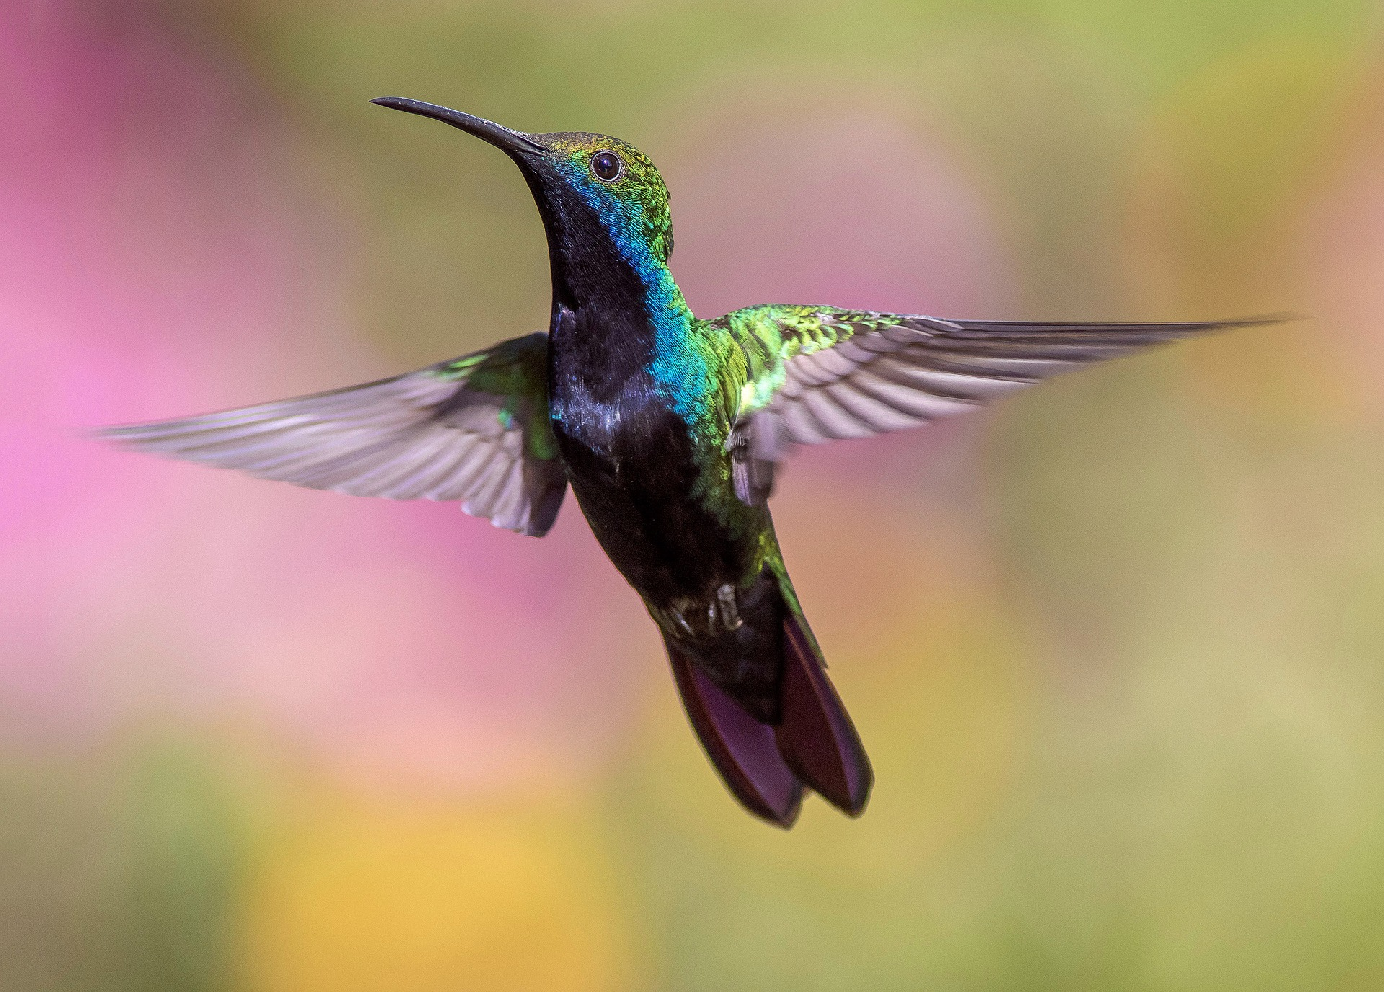

Birdcall Identification
Project : AI/Machine Learning
Project Problem(definition),
AI Solution
& Project Demo

Slide 2

Contents
Motivation
Data Description
Audio signal processing
Machine learning model
Demo
Results
Conclusion and future work

Slide 3
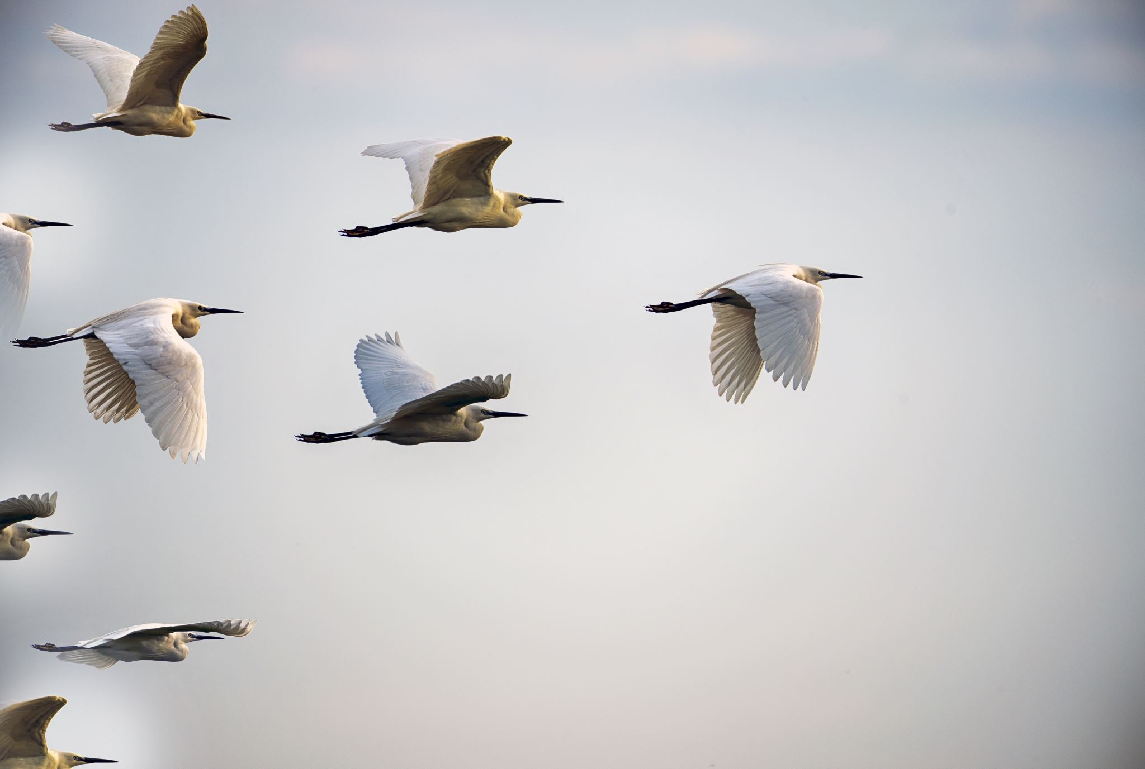
Motivation and Objectives
In terms of application
Explorers
Bird watchers
Researchers and Biologists
In terms of Implementation
Challenge of classifying audio data
Complex and multi-layered prediction model
Includes audio signal processing and machine learning
User-friendly web application

Slide 4

Data Description
Audio data is in MP3 format
Kaggle birdcall-identification dataset
4 out of 30 birds that are local to Indiana State
American Robin
Blue Jay
House sparrow
Northern Cardinal
Train set contains 150 audio files (on average) for each bird
Test/Validation set contains 20 audio files of each bird

Slide 5
Data-Preprocessing
Audio Signal Processing Steps:
Convert MP3 to wav format
Using Librosa python library compute Mel Spectrogram
Convert the colour spectrogram to gray image of a pre-defined size
Save the image

Slide 6
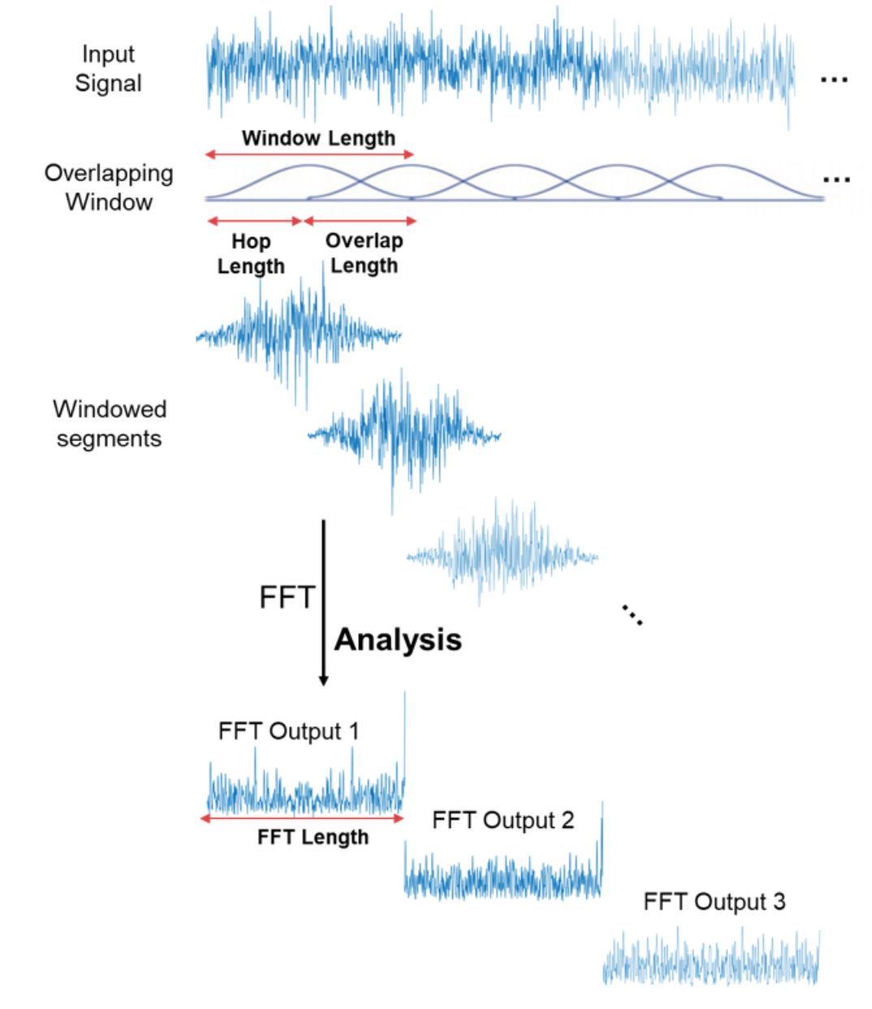
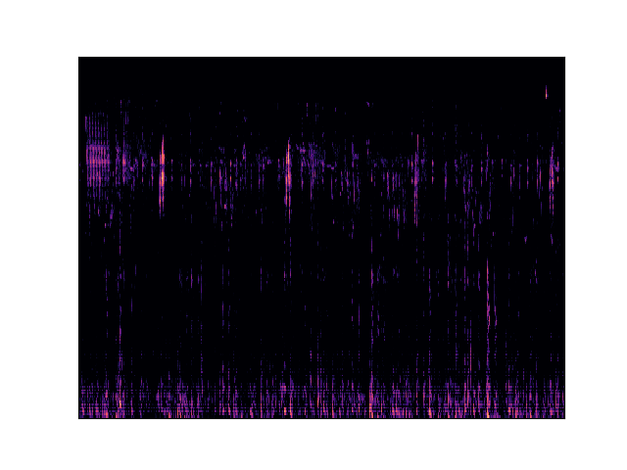
Audio signal processing
The Fourier transform
Fast Fourier Transform is the algorithm
Short Fourier Transform (STFT) for non-periodic signals to produce spectrogram
A mel spectrogram is a spectrogram where the frequencies are converted to the mel scale
Notes:
Important information in the audio is in the frequency domain
FT decompose a signal into individual frequencies and the frequency’s amplitude
STFT - The FFT is computed on overlapping windowed segments of the signal, and we get what is called the spectrogram
FFT is computed on overlapping windowed segments to produce spectrogram
Mel scale - A unit of pitch such that equal distances in pitch sounded equally distant to the listener

Slide 7
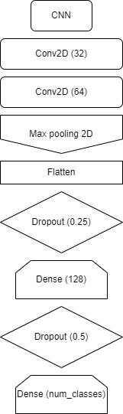
Machine Learning Model
Conv2D layer
Max Pooling layer
Flatten
Dropout
Dense

Slide 8
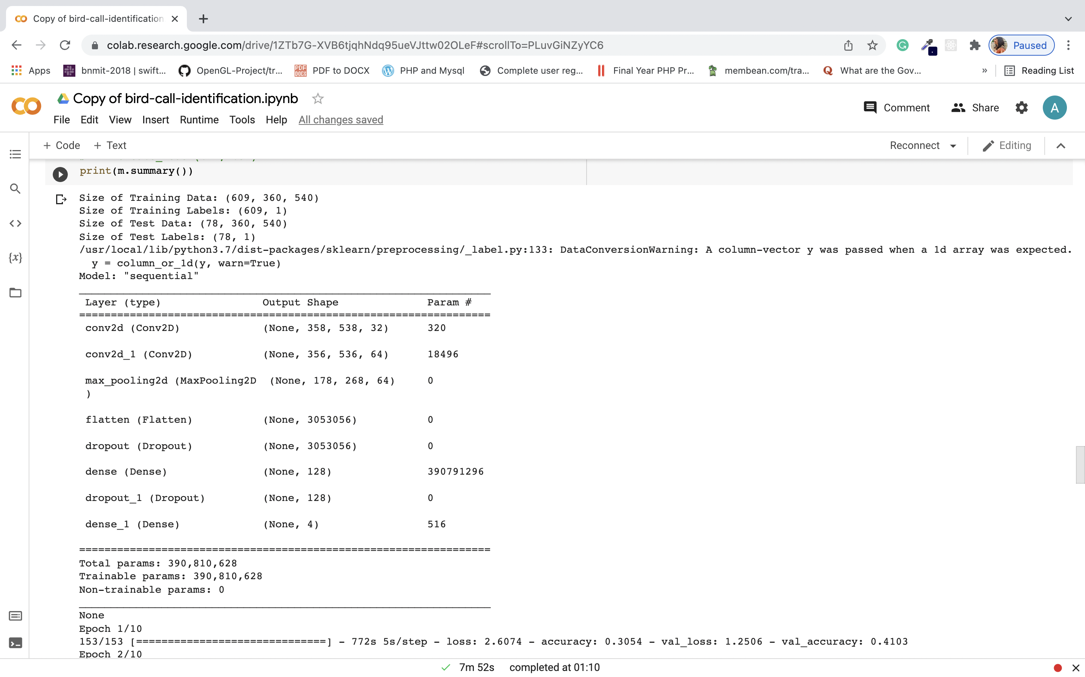
Model Summary

Slide 9
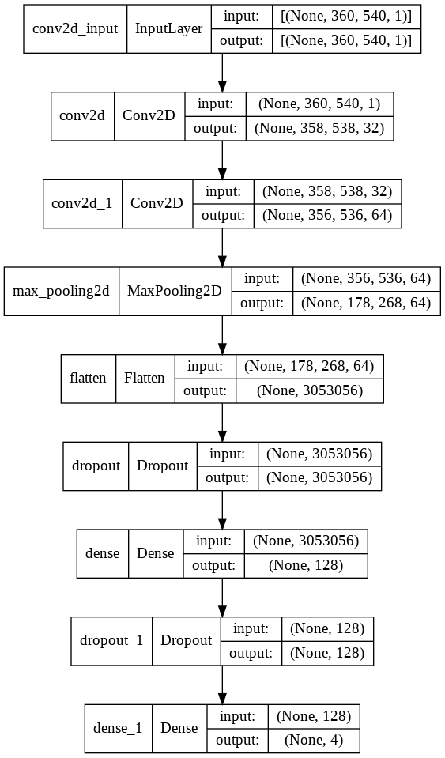
Machine learning model
Model summary visualization

Slide 10
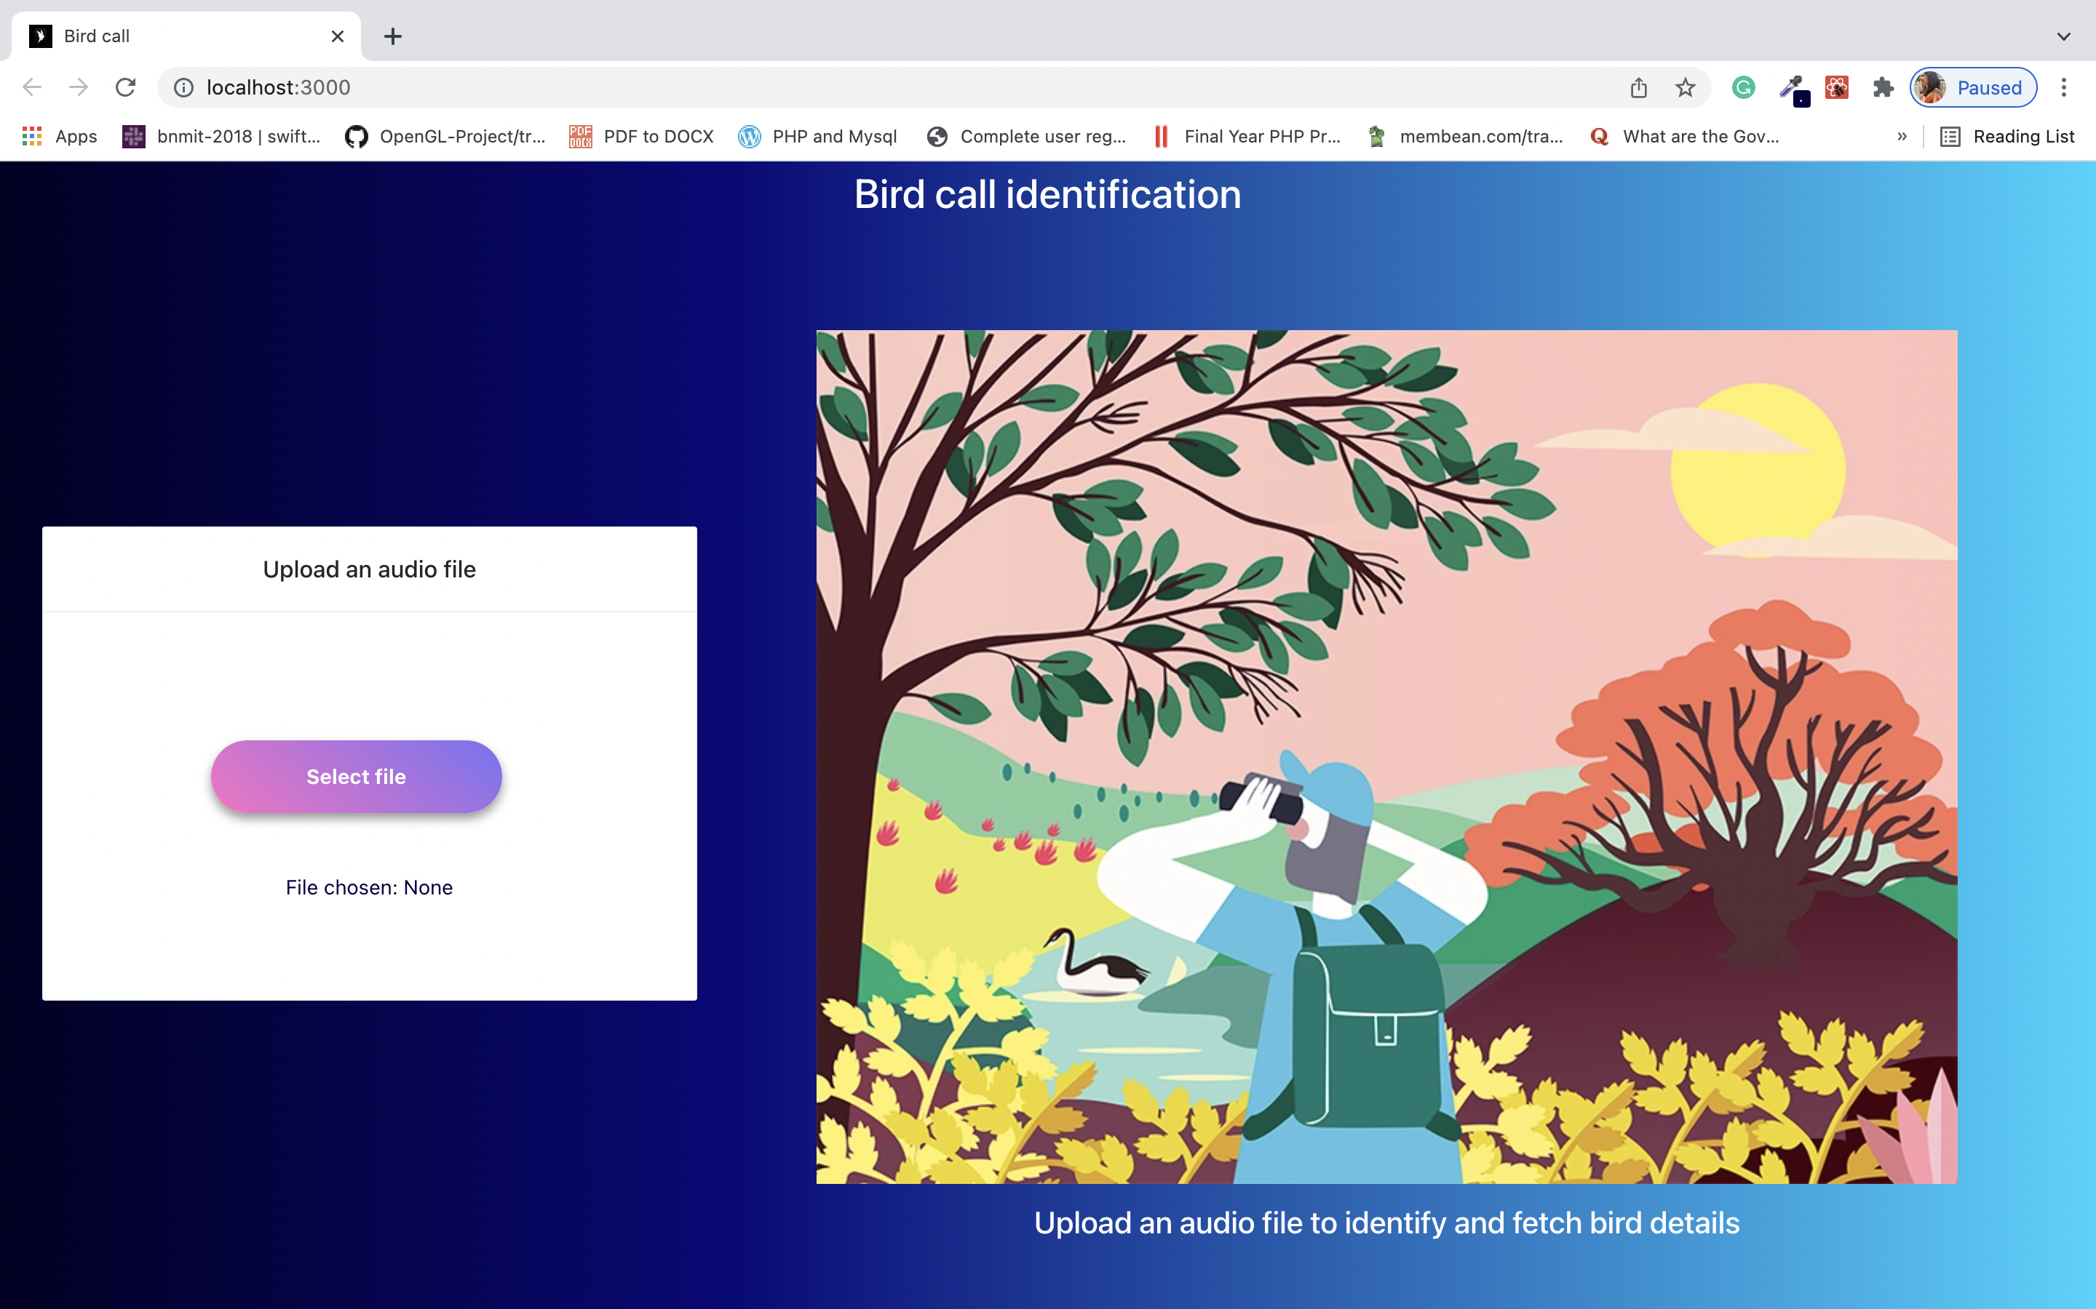
User Interface

Slide 11
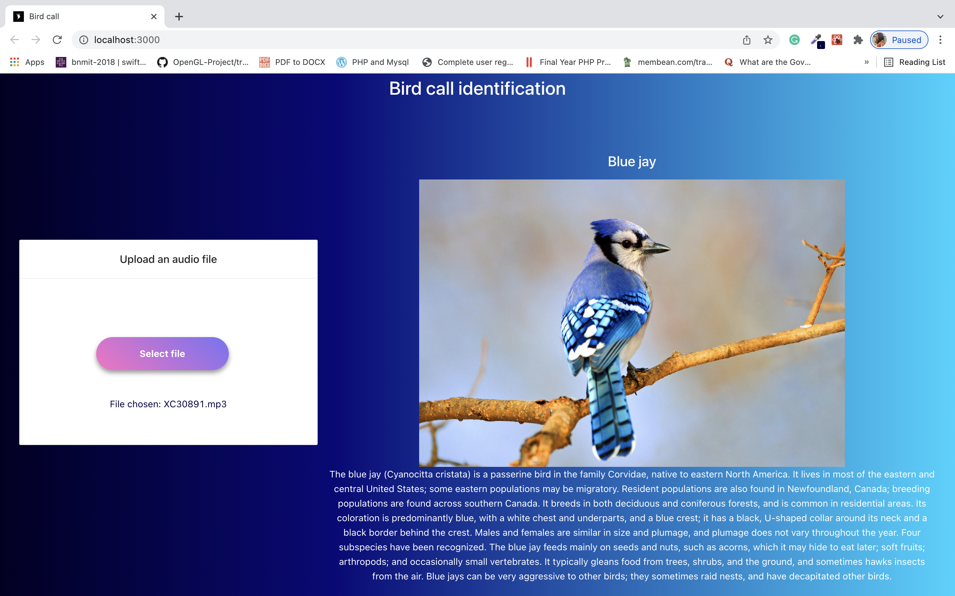

Slide 12

Webpage Demo

Slide 13
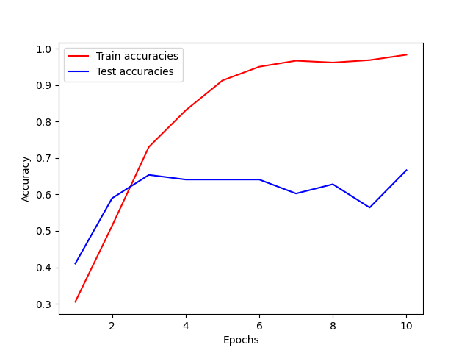
Result
Accuracy of the model (After 10 epochs)
Training accuracy – 0.983 (98.3%)
Testing accuracy – 0.667 (66.7%)

Slide 14
Conclusion and Future Work
Future Work
Training of model with more birds
Trying to improve the model accuracy
Adding more features to user interface

Slide 15
References
B. Chandu, A. Munikoti, K. S. Murthy, G. Murthy V. and C. Nagaraj, "Automated Bird Species Identification using Audio Signal Processing and Neural Networks," 2020 International Conference on Artificial Intelligence and Signal Processing (AISP), 2020, pp. 1-5, doi: 10.1109/AISP48273.2020.9073584. https://ieeexplore.ieee.org/document/9073584
Dataset - https://www.kaggle.com/vlomme/my-birdcall-datasets
Website reference - https://birdnet.cornell.edu/
Digit recognition using audio - https://medium.com/x8-the-ai-community/audio-classification-using-cnn-coding-example-f9cbd272269e
CNN explanation- https://machinelearningmastery.com/convolutional-layers-for-deep-learning-neural-networks/
Audio Signal processing - https://www.audiolabs-erlangen.de/resources/MIR/FMP/B/B_PythonAudio.html
Keras API references - https://keras.io/api/

Slide 16

Thank you

